Slide 1
IPL Match Bidding App
Presented By:
Group No: 09

Slide 2
AGENDA
Introduction to the Problem Statement.
Data Description
Problem-Solving Steps
Insights
Takeaways & conclusions

Slide 3
Introduction
Problem Statement:
Pie-in-the-Sky is a mobile app that is used for bidding for IPL matches legally.
In this project, we are going to discuss the IPL team win prediction.
Based on some match stats, we’re predicting who is the winner of an IPL match.
Through this project, we will get familiar with the exploratory data analysis and feature engineering techniques that need to be applied to process data.
Match
details
Winner
Update team points and final winner
Update bidders leader board.
The current standing of the teams on the points table
Playing team
The venue of the match
Predict Winner
Allows the user to predict the winner of the match before the toss happens for the match on which the user is predicting
Point System
Every win, users get points
The Point system is very dynamic.
Leader board
User will be able to see his/her points and his/her position in the overall user standings.
Can see
top 3 leader positions

Slide 4
Data Description
.

Slide 5
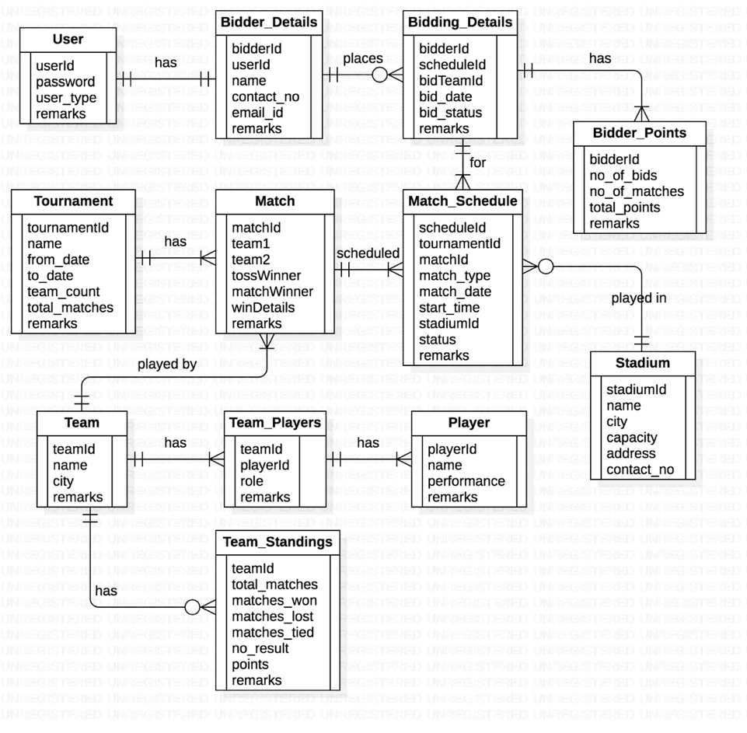
Use the IPL dataset
“ Which contains the details regarding the winner and match stats”

Slide 6





Problem-solving steps
Understanding
Identify the problem
plan the solution
Implement the solution
Evaluate result
Understanding all the tables and relationship between the one table to another
Discuss the problem with all the group member to identify the problem
Plan for how to solve the problem statement
Start to solve the questions as per problem statement in different way
Tried with different method to solve the problem and get the best solution

Slide 7
In-Sights
Bidder Details
IPL TEAMS
Top 3 Bidder are : - According to winning percentage)
Megaduta Dheer (Total wins 5 out of bids)
Arybhatta Parachure ( TotaL wins 10 out of 11 bids)
Akshara Pandey (Total wins 5 out of 6 bids).
The team who won the most of the bids on toss is the bidder – “ID 121” Aryabhata Parachure .
Aryabhata Parachure has the top-of-the-point table in both months of 2017 Total points in a single month is 35.
The bidder who did get any point is (Krishan Vlimbe ,Gagan Panda, Ronald D’Souza).
Most bid team is Sunrise Hyderabad number of bids are 32.
The team that wins most of the matches is Chennai Super Kings (18 wins out of 28 matches)
The team that lost the most is Royal Challengers Bangalore (lost 18 matches out of 28 matches with 1 tie).
Top 3 teams that have the max number of all-rounders are:-
Delhi Daredevils (7 all-rounders)
Kings XI Punjab (7 all-rounders)
Kolkata Knight Riders (5 all-rounders)
The most wicket-taking bowler is Andrew tye from Kings XI Punjab with 24 wickets.

Slide 8
The chances of winning the bids are more if you bid for the team “Chennai Supper king”. And The best bidder In the pie in the sky mobile app in 2017 is “Arybhatta Parachure” .
Conclusions
“
”

Slide 9
“
Thank You
Qns???
“

